Slide 1


TOLA ABRAHAMS
03-22-2023
Lutollar@gmail.com

Slide 2

Outline
Executive Summary
Introduction
Methodology
Results
Conclusion
Appendix

Slide 3
Executive Summary
Summary of methodologies
Data Collection: using GET request, data wrangling and formatting
Data wrangling: perform EDA and determining training labels
EDA & Visualization: perform EDA & feature engineering with Panda & Matplotlib
EDA with SQL: query the data for insights on datasets from the database
Analysis with SQL: perform analysis & visualization with maps on Folium
Visualization using Plotly: Build interactive real-time dashboards for visualization using plotly dash
Classification using Machine Learning : Build various classification models and test for best performance
Summary of all results
Data was collected, cleaned, formatted and exported to csv
Data was analyzed and labelled with dependant and target variables and further split into training and testing set
maps, charts and plots showed insights into launch site, landing success rate, payload mass and booster versions
Machine learning models were created and evaluated to show the best models, best accuracy and confusion matrix

Slide 4
Introduction
SpaceX has gained worldwide attention for a series of historic milestones. It is the only private company ever to return a spacecraft from low-earth orbit, which it first accomplished in December 2010. SpaceX advertises Falcon 9 rocket launches on its website with a cost of 62 million dollars whereas other providers cost upward of 165 million dollars each, much of the savings is because Space X can reuse the first stage.
Therefore if we can determine if the first stage will land, we can determine the cost of a launch. This information can be used if an alternate company wants to bid against SpaceX for a rocket launch. In this project, we will collect and make sure the data is in the correct format from an API clean the data and analyse it for insights, visualize the trends and build several classification models to predict the success of future launch based on the data provided.

Slide 5

Section 1

Slide 6
Methodology
Executive Summary
Data collection methodology:
Get request sent to SpaceX API, Data wrangling, cleaning and formatting
Scrapping Falcon9 Launch table from its Wiki URL page and parsing it to a dataframe
Perform data wrangling
Perform Exploratory Analysis & Determine training tables
Perform exploratory data analysis (EDA) using visualization and SQL
Perform Exploratory data analysis & feature engineering using Pandas & Matplotlib
Understanding the SpaceX dataset, loading the data into the tables in DB2 database and executing SQL queries to understand the SpaceX dataset
Perform interactive visual analytics using Folium and Plotly Dash
Build a Folium map object with launch site coordinates and with markers showing proximities to coastlines, railroads, highways and cities.
Build an interactive dashboard visual on SpaceX data in real time using plotly dash
Predictive analysis using classification models
Perform EDA and determine the training labels, create column for “Class” our target variable, standardize the data, split into training and test data for classification and test the models for accuracy to determine best performing model.

Slide 7
Data Collection
Get request sent to SpaceX API, Data wrangling, cleaning and formatting.
Import Libraries and define functions
Request rocket launch data from SpaceX API with URL
Request & Parse SpaceX launch data using GET Request
Decode the data and turn it into a Pandas dataframe
Filter the dataframe to only include our target variable
Deal with missing values and replace them
Export the cleaned data into CSV
https://github.com/MoAbbazi/IBM-Data-science-capstone/blob/main/DATA%20COLLECTION%20LAB%20SPACEX%20CAPESTONE.ipynb

Slide 8
Data Collection – Web Scraping
Scrapping Falcon9 Launch table from its Wiki URL page and parsing it to a dataframe
Import libraries
Define functions to scrape HTML table
Request the falcon 9 Launch wiki page from its URL
Extract all Columns / Variable names from HTML table header
Create a dataframe by parsing the launch HTML table
Export the table to CSV
https://github.com/MoAbbazi/IBM-Data-science-capstone/blob/main/WEBSCRAPPING%20LAB%20SPACEX%20CAPESTONE.ipynb

Slide 9
Data Wrangling
Perform Exploratory Analysis & Determine training tables
Import libraries & Define auxiliary functions
Load the dataset and clean the data
Calculate the number of launches on each site
Calculate the number of occurrences of each orbit
Calculate the number of occurrences of mission outcome per orbit type
Create a landing outcome label from outcome column as target categorical variable
Export the analysed data into CSV
https://github.com/MoAbbazi/IBM-Data-science-capstone/blob/main/DATA%20WRANGLING%20LAB%20SPACEX%20CAPESTONE_2.ipynb

Slide 10
EDA with Data Visualization
Perform Exploratory data analysis & feature engineering using Pandas & Matplotlib
Import libraries & define auxiliary functions
Import dataset and perform EDA to visualize the trends
Visualize relationship between flight number and launch site
Visualize relationship between payload and launch site
Visualize the relationship between success rate of each orbit type
Visualize the relationship between flight number and orbit type
Visualize the relationship between payload and orbit type
Visualize the launch success yearly trend
Create dummy variable for feature engineering using one hot encoding
Call all numeric columns to float64
Export the final data to CSV
https://github.com/MoAbbazi/IBM-Data-science-capstone/blob/main/EDA%20Visualization%20Lab%20SPACEX%20Capstone.ipynb

Slide 11
EDA with SQL
Understanding the SpaceX dataset, loading the data into the tables in DB2 database and executing SQL queries to understand the SpaceX dataset
Download the data and connect to the DB2 database
Explore data by displaying names of unique launch sites
Records of launch sites with CCA
Display total payload mass carried by boosters launched by NASA (CRS)
Display average payload mass carried by booster version F9 V1.1
List the date when the first successful landing outcome in the past was achieved
Names of boosters with success in drone ships with payload between 4000-6000
List the total number of successful and failure mission outcomes
Names of booster versions which have carried maximum payload mass
Query drone failure outcome, booster version and launch site for 2015
Ranking successful landing outcomes from June 2010 to March 2017
https://github.com/MoAbbazi/IBM-Data-science-capstone/blob/main/EDA%20SQL%20LITE%20LAB%20SPACEX%20CAPSTONE.ipynb

Slide 12
Build an Interactive Map with Folium
Build a Folium map object with launch site coordinates and with markers showing proximities to coastlines, railroads, highways and cities.
Launch site location analysis using maps with Folium
Create a map object with Folium using NASA launch site coordinates as centre
Mark all launch sites on the map using folium marker object
Mark all successful and failed mission sites on the map using marker
Calculate the distance between the launch site locations and their closest proximities to highways, railroads, coastlines and cities
Use the insights obtained from the map to draw conclusions on the launch site locations
https://github.com/MoAbbazi/IBM-Data-science-capstone/blob/main/ANALYSIS%20AND%20VIZ%20WITH%20FOLIUM%20SPACEX%20CAPSTONE_3.ipynb

Slide 13
Build a Dashboard with Plotly Dash
Build an interactive dashboard visual on SpaceX data in real time using Plotly dash
Create a dash application component which contains input components such as dropdown list and range sliders to display pie chart and scatter point chart
Add a launch site dropdown input component
Add a callback function that renders “Success pie chart” based on selected site dropdown
Adda arrange slider to select payload
Add a call back function to render the “success payload scatter plot”
Launch the interactive web dashboard on a private IP/Port: 127.0.0.1 / 8050
https://github.com/MoAbbazi/IBM-Data-science-capstone/blob/main/Dash%20Interactive%20Dashboard%20SPACEX%20CAPSTONE.ipynb

Slide 14
Predictive Analysis (Classification)
Perform EDA and determine the training labels, create column for “Class” our target variable, standardize the data, split into training and test data for classification and test the models for accuracy to determine best performing model.
Import libraries and load the dataset and Define the plot_confusion_matrix
Create NumPy array with column “Class” and assign it to variable Y then we Standardize the data in X and assign it to Variable X
Split the data into training and testing data
Create Logistic regression object and GridSearchCV object and find best parameters : {'C': 0.01, 'penalty': 'l2', 'solver': 'lbfgs’} and accuracy : 0.8464285714285713 determine test accuracy:0.8333333333333334 and plot confusion matrix
Create SVM object and GridSearchCV object and find best parameters: {'C': 1.0, 'gamma': 0.03162277660168379, 'kernel': 'sigmoid’} and accuracy : 0.8482142857142856 determine test accuracy:0.8482142857142856 and plot confusion matrix
Create Decision tree classifier object with GridSearchCV object and find best parameters: {'criterion': 'gini', 'max_depth': 6, 'max_features': 'auto', 'min_samples_leaf': 4, 'min_samples_split': 2, 'splitter': 'random’} and accuracy : 0.9017857142857144 determine the test accuracy: 0.8333333333333334 and plot confusion matrix
Create a KNN object with GridSearchCV object and find best parameters: {'algorithm': 'auto', 'n_neighbors': 10, 'p': 1} and accuracy : 0.8482142857142858 determine the test accuracy : 0.8333333333333334 and plot a confusion matrix
We compare all the models to determine the best performing which is the decision tree classifier with training accuracy: 0.9017857142857144
https://github.com/MoAbbazi/IBM-Data-science-capstone/blob/main/MACHINE%20LEARNING%20LAB%20SPACEX%20CAPSTONE_5.ipynb

Slide 15
Results
Exploratory data analysis results
From our scatter plot for Flight number Vs Payload mass see that different launch sites have different success rates. CCAFS LC-40, has a success rate of 60 %, while KSC LC-39A and VAFB SLC 4E has a success rate of 77%.)
Also from our Payload Vs. Launch Site scatter point chart you will find for the VAFB-SLC launch site there are no rockets launched for heavy payload mass(greater than 10000)
From scatter plot between orbit and Flight number we see that in the LEO orbit the Success appears related to the number of flights; on the other hand, there seems to be no relationship between flight number when in GTO orbit.
Also from the scatter plot between Orbit and Payload mass With heavy payloads the successful landing or positive landing rate are more for Polar,LEO and ISS.
However for GTO we cannot distinguish this well as both positive landing rate and negative landing(unsuccessful mission) are both there here.

Slide 16
Results
Predictive analysis results
After using the function train_test_split to split the data X and Y into training and test data. Set the parameter test_size to 0.2 and random_state to 2 we have a train shape of 72 and test shape of 18.
We obtained best parameters for the Logistic regression as tuned hpyerparameters :(best parameters) {'C': 0.01, 'penalty': 'l2', 'solver': 'lbfgs’}, accuracy : 0.8464285714285713
For our SVM we obtained tuned hpyerparameters :(best parameters) {'C': 1.0, 'gamma': 0.03162277660168379, 'kernel': 'sigmoid’}, accuracy : 0.8482142857142856
For our Decision tree we obtained tuned hpyerparameters :(best parameters) {'criterion': 'gini', 'max_depth': 6, 'max_features': 'auto', 'min_samples_leaf': 4, 'min_samples_split': 2, 'splitter': 'random’}, accuracy : 0.9017857142857144
And for the KNN we got tuned hpyerparameters :(best parameters) {'algorithm': 'auto', 'n_neighbors': 10, 'p': 1}accuracy : 0.8482142857142858
We plot a confusion matrix for each of the classification methods used.
Each model had the same Accuracy on test data: 0.8333333333333334

Slide 17

Section 2

Slide 18
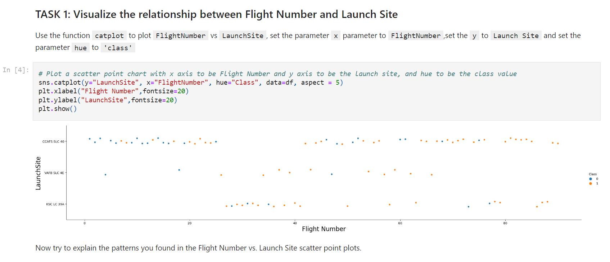
Flight Number vs. Launch Site
The VAFB SLC Launch site showed more flight success from flight number 18 upwards.

Slide 19
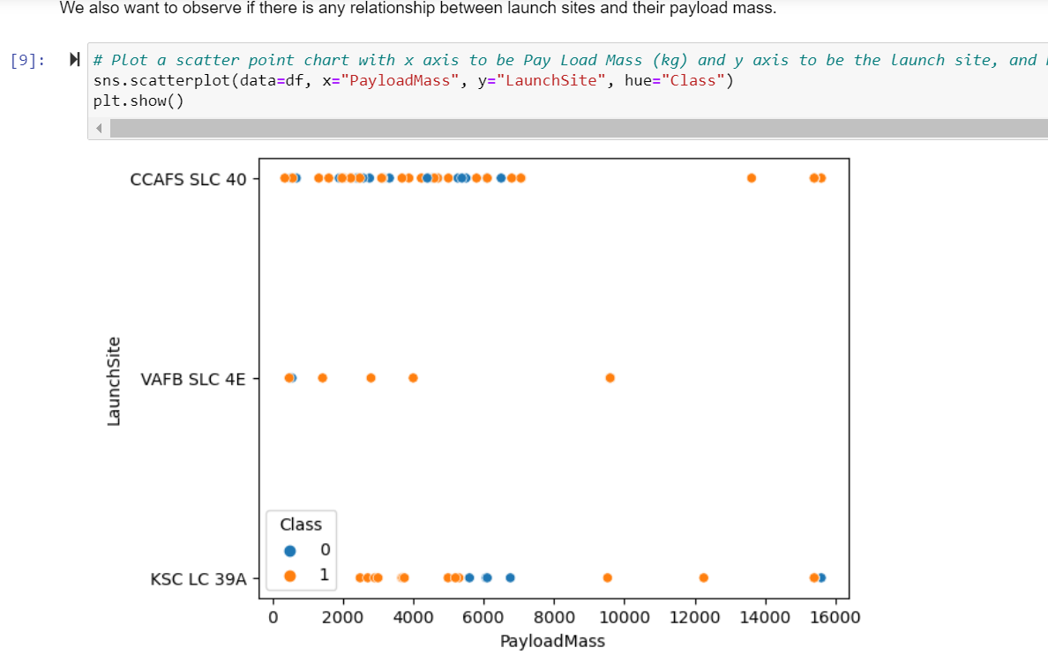
Payload vs. Launch Site
The launch site VAFB SLC showed success with payload mass from 1000 while KSC showed no success at +/-6000

Slide 20
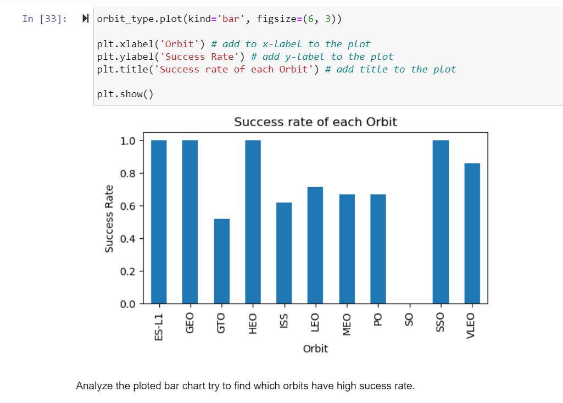
Success Rate vs. Orbit Type
The Orbits ES-L1, GEO, HEO, SSO and VLEO all have very high success rates

Slide 21
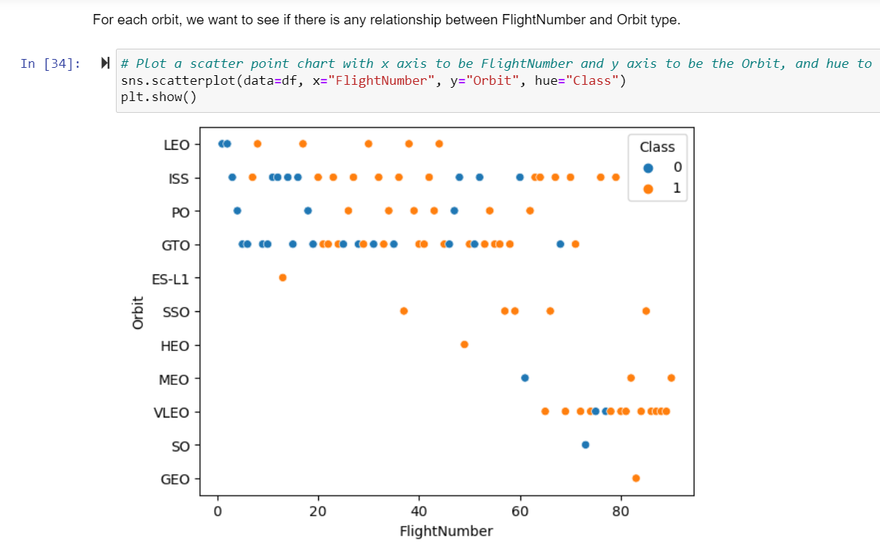
Flight Number vs. Orbit Type
You should see that in the LEO orbit the Success appears related to the number of flights; on the other hand, there seems to be no relationship between flight number when in GTO orbit.

Slide 22
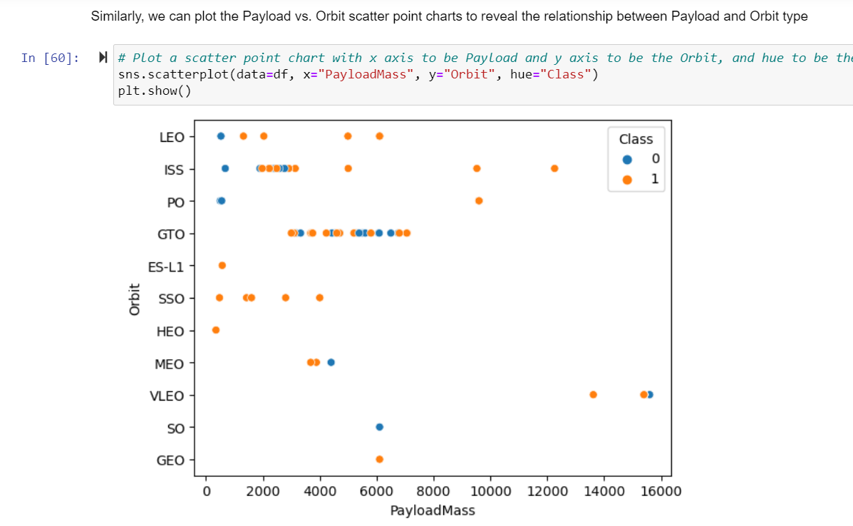
Payload vs. Orbit Type
With heavy payloads the successful landing or positive landing rate are more for Polar, LEO and ISS.
However for GTO we cannot distinguish this well as both positive landing rate and negative landing (unsuccessful mission) are both there here.

Slide 23
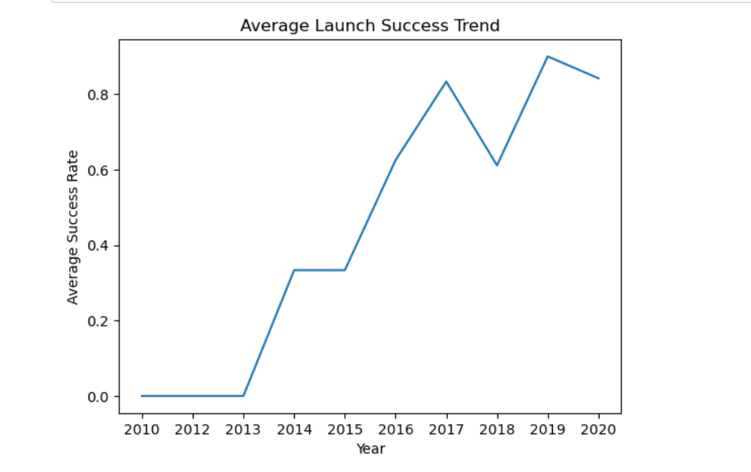
Launch Success Yearly Trend
You can observe that the success rate since 2013 kept increasing till 2020

Slide 24
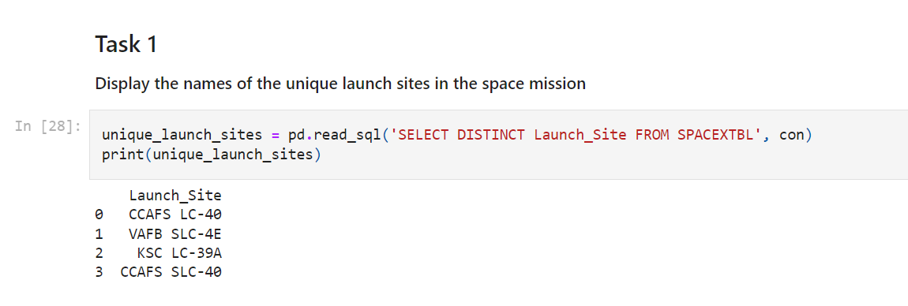
All Launch Site Names
There are four unique launch site in the space mission CCAFS LC, VAFB SLC, KSC LC, CCAFS SLC.

Slide 25
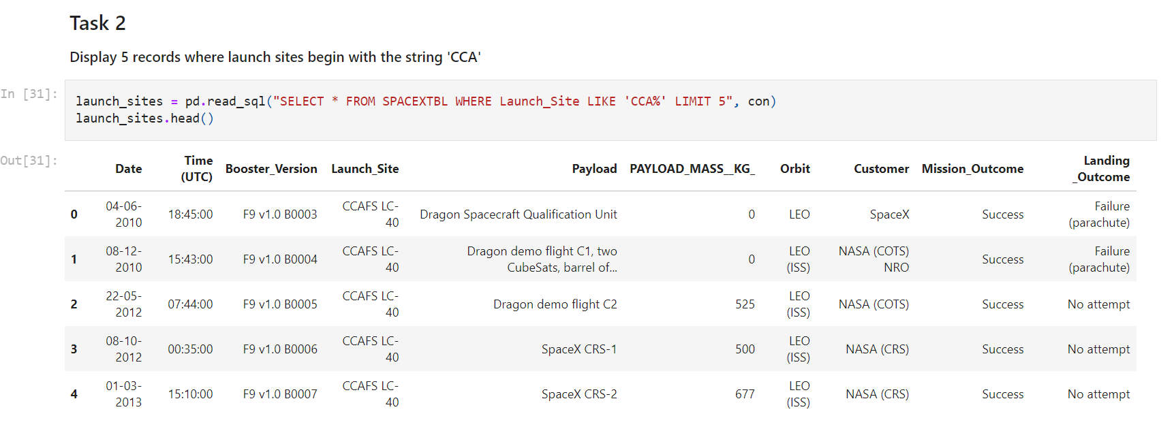
Launch Site Names Begin with 'CCA'
ALL 5 RECORDS WITH CCA WHERE LAUNCHED TO LEO ORBIT BY NASA AND SPACEX AND ALL WERE SUCCESSFUL

Slide 26
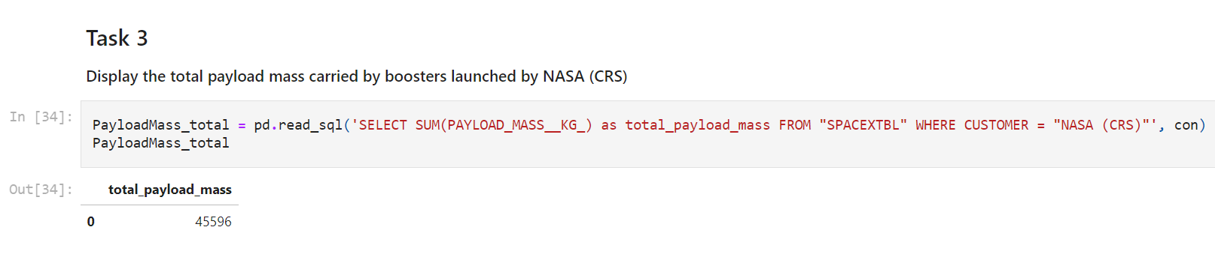
Total Payload Mass
The total payload mass carried by boosters launched by NASA (CRS) is 45596.

Slide 27
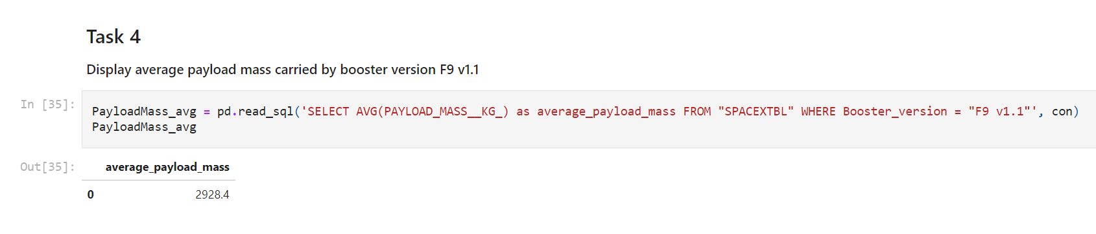
Average Payload Mass by F9 v1.1
The average payload mass carried by booster version F9 v1.1 is 2928.4

Slide 28
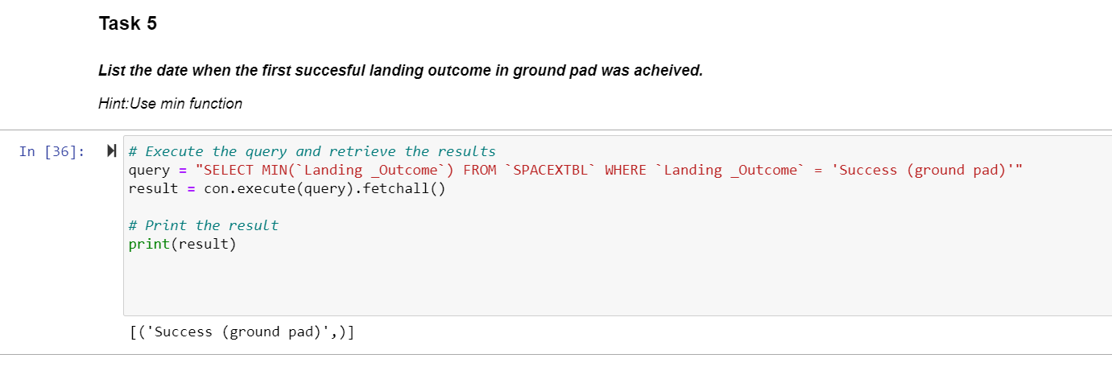
First Successful Ground Landing Date
No record was found for successful ground landing date.

Slide 29
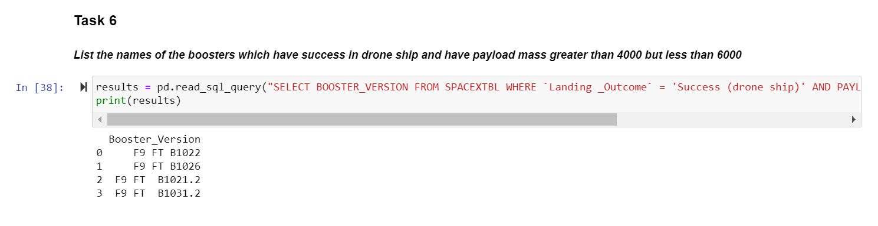
Successful Drone Ship Landing with Payload between 4000 and 6000
There were 4 records found for the boosters which have success in drone ship and have payload mass greater than 4000 but less than 6000.

Slide 30
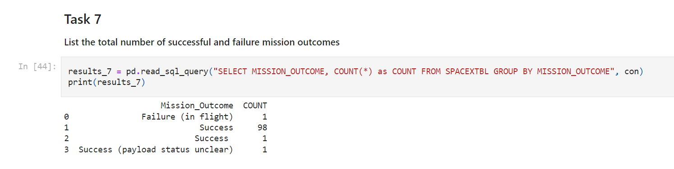
Total Number of Successful and Failure Mission Outcomes
The total number of successful missions were 100 while the failed mission is 1.

Slide 31
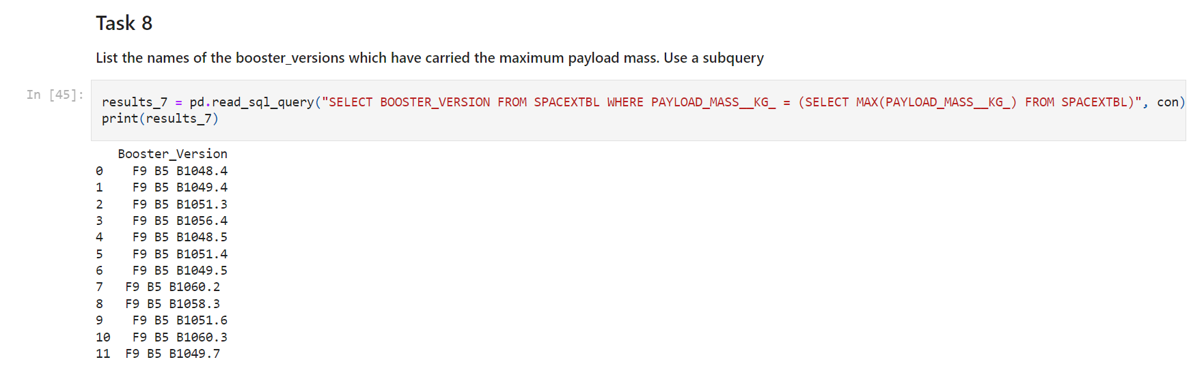
Boosters Carried Maximum Payload
There were a total of 12 F9 B5 Booster versions that have carried the maximum payload mass

Slide 32
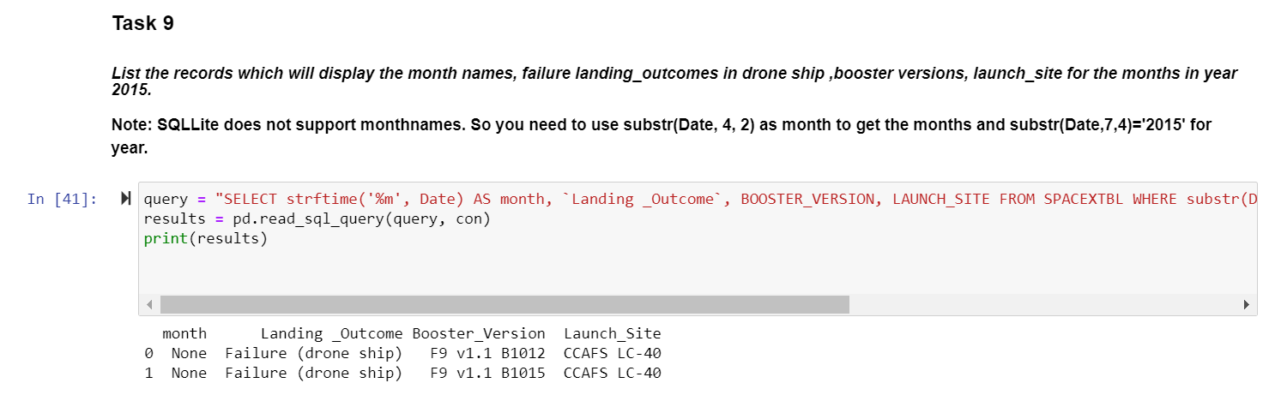
2015 Launch Records
There were 2 records found for month names, failure landing_outcomes in drone ship, booster versions and launch_site for the months in the year 2015

Slide 33
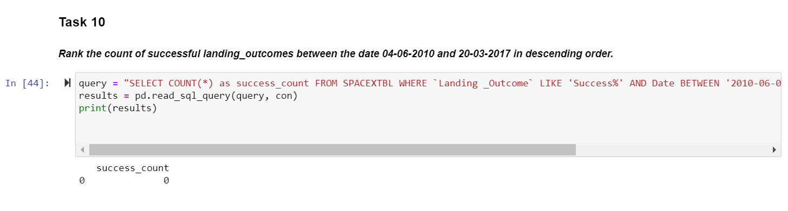
Rank Landing Outcomes Between 2010-06-04 and 2017-03-20
There was no record found for landing outcomes between June 2010 and March 2017

Slide 34

Section 3

Slide 35
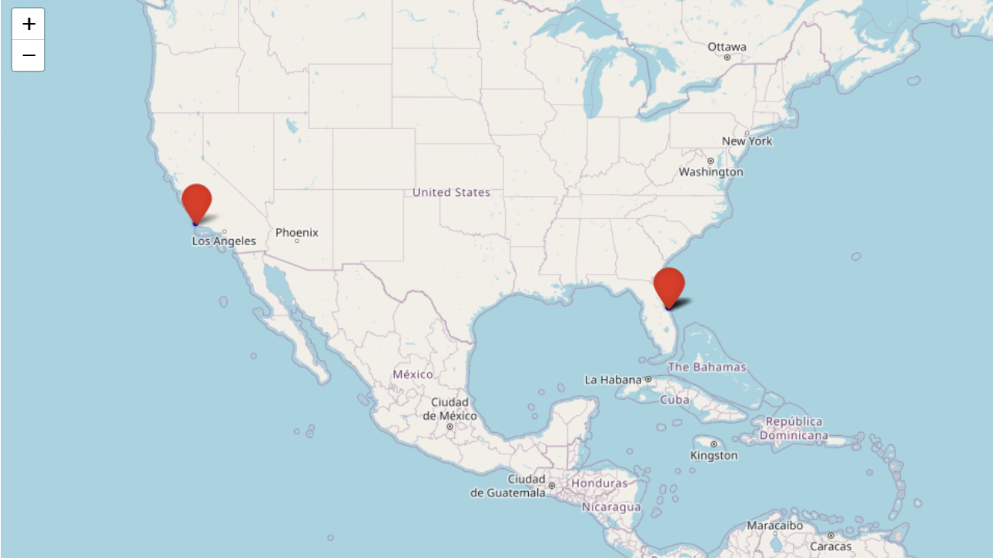
Folium Map showing Launch sites
The Folium map showing Launch sites for SpaceX Falcon 9 missions

Slide 36
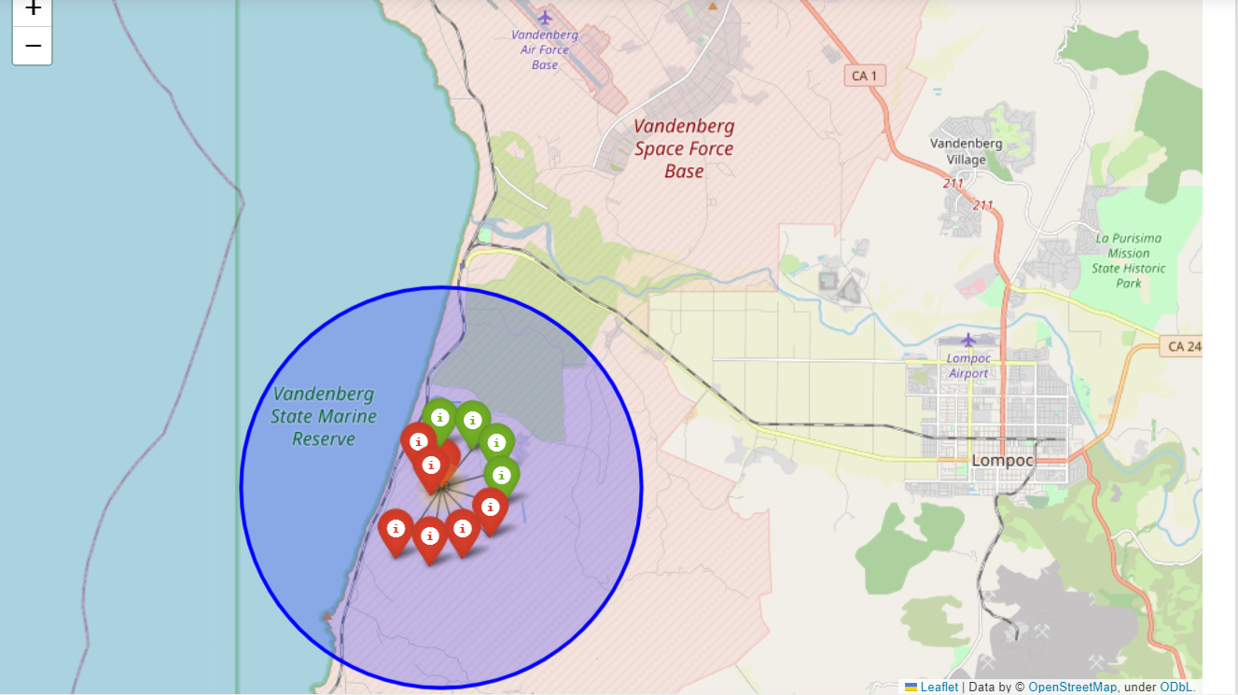
Folium Map showing mission outcome Launch sites
Folium map with clusters and markers indicating successful and failed mission launch sites

Slide 37
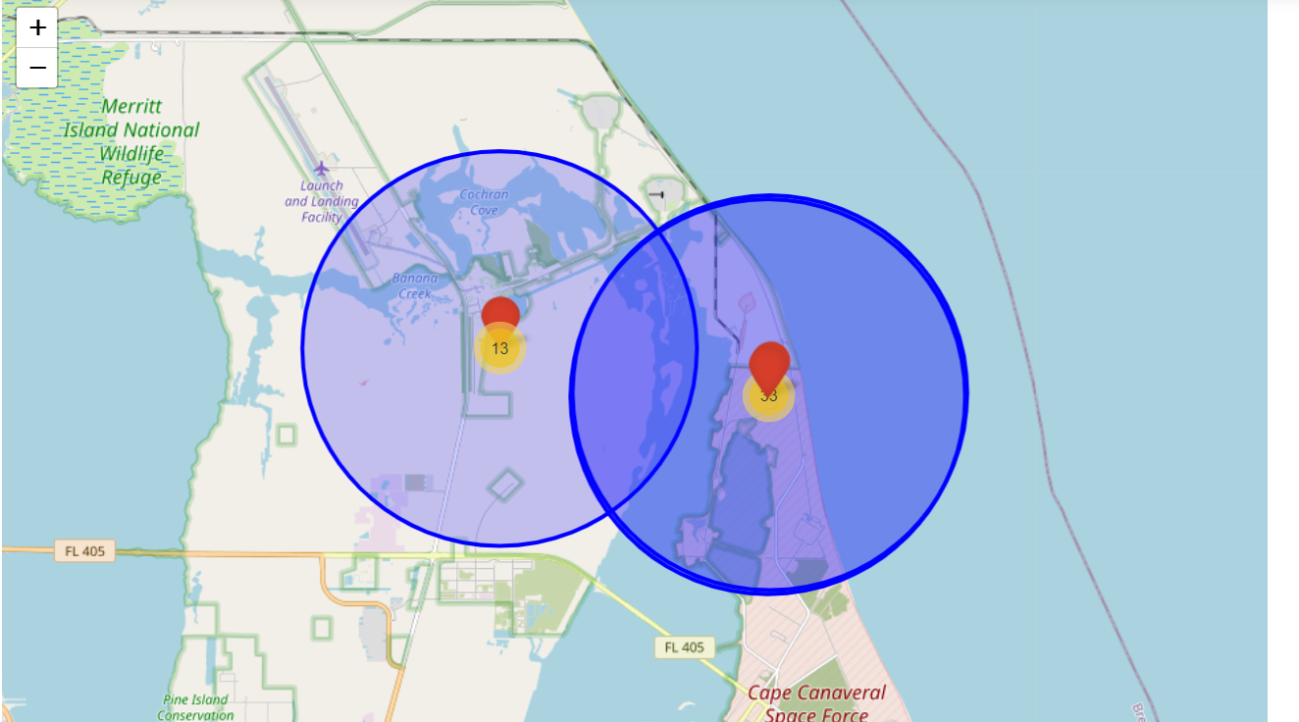
Folium Map showing Proximities
Folium map showing launch site proximities to highways, railroads, coastlines and cities

Slide 38

Section 4

Slide 39
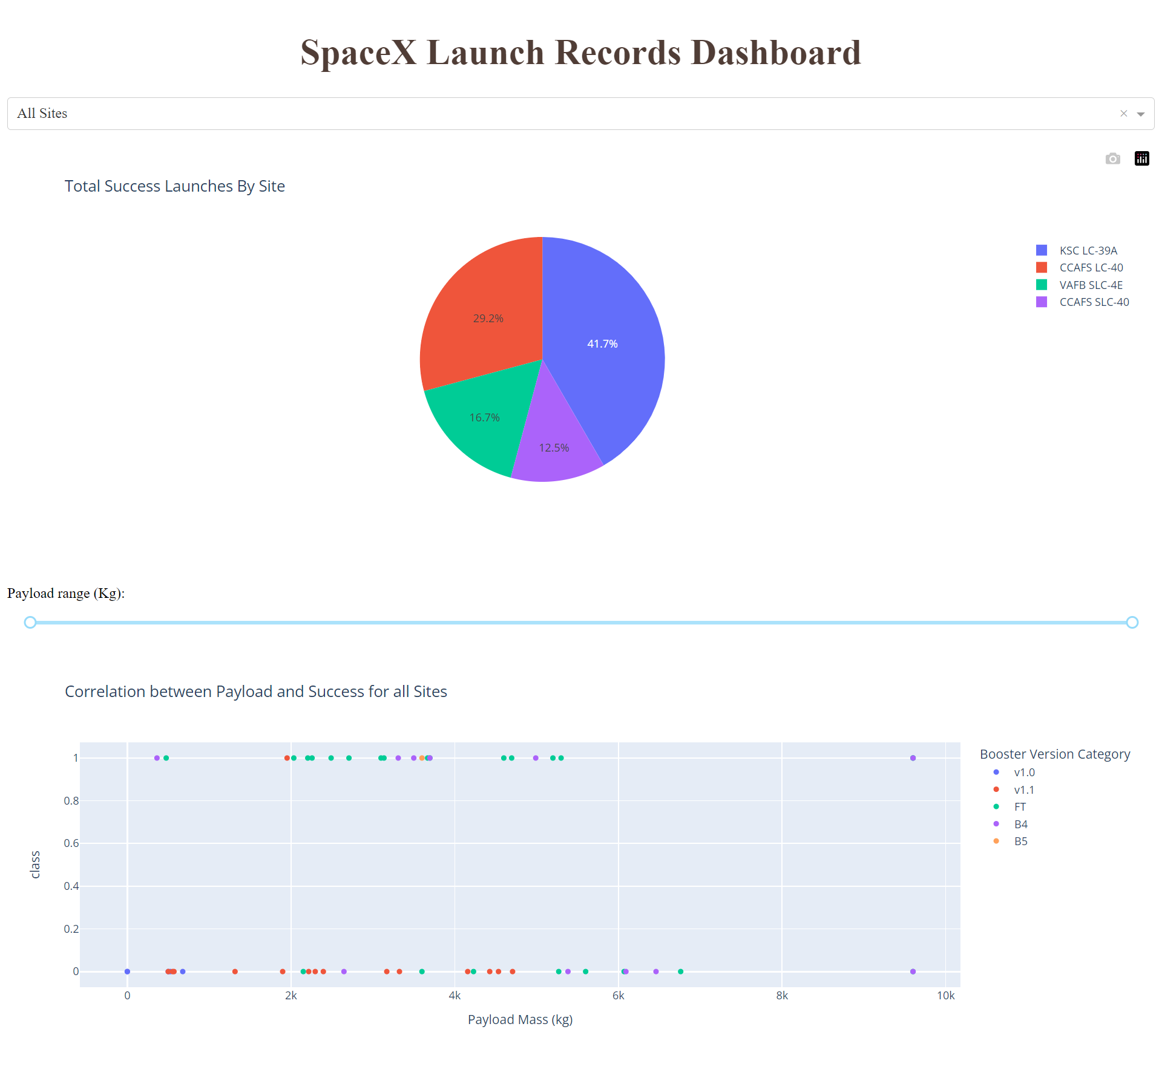
SpaceX Dashboard showing Total success Launch by site
The pie chart shows total success launches for all launch sites with KSC LC 39A & CCAFS LC 40 performing best

Slide 40
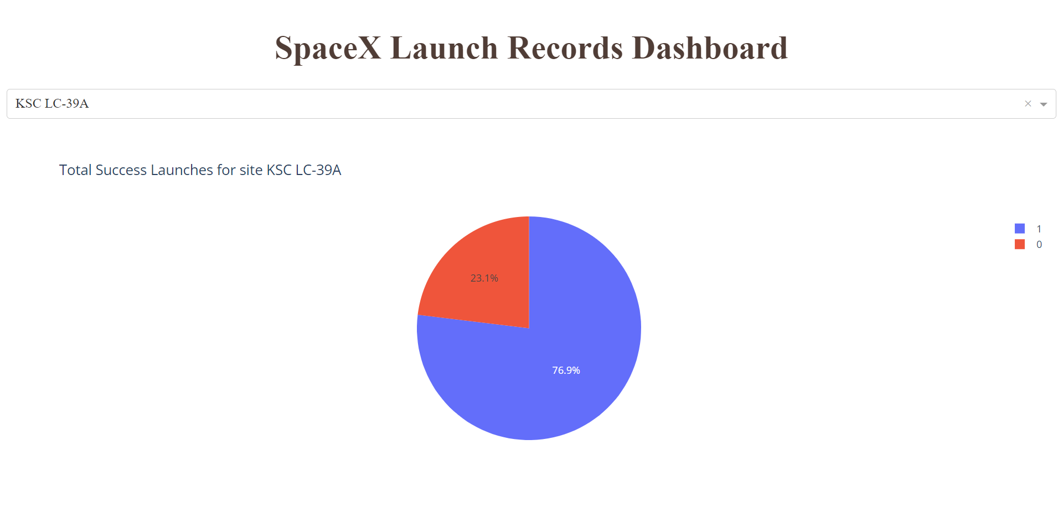
Dashboard showing Pie chart of best Launch site
The pie chart shows the best performing launch site KSC LC-39A with 76.9% success & 23.1% failed missions

Slide 41
Dashboard showing Payload mass & Success rate
The scatter plot shows booster v1.0 and FT performing best with success from 0 to 10k and 6k maximum Payload mass respectively while others had success below 5k.

Slide 42

Section 5

Slide 43
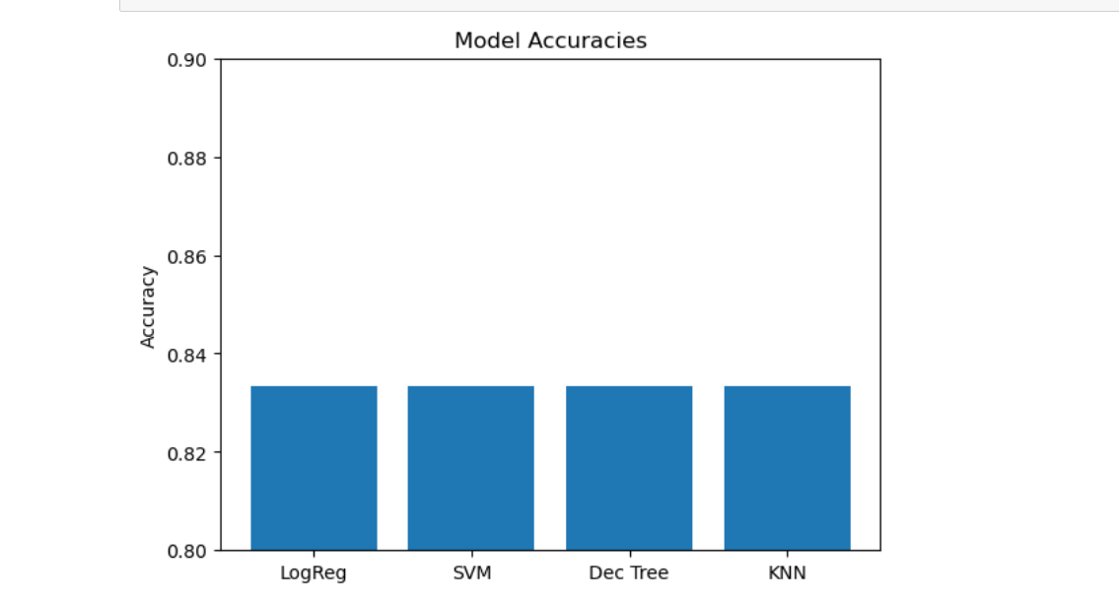
Classification Accuracy
All models had the same accuracy in the test set of 0.8333333333333334 while the Decision tree classifier had a higher accuracy in the training set with 0.9017857142857144

Slide 44
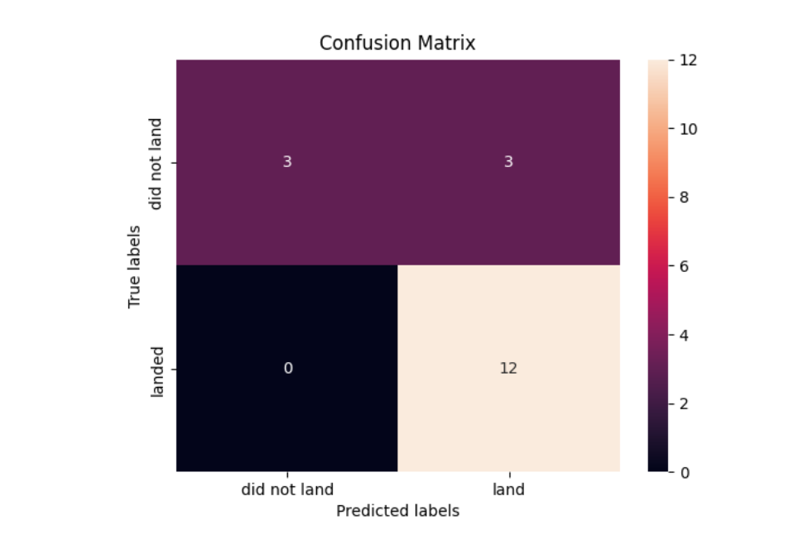
Confusion Matrix
Examining the confusion matrix, we see that Decision tree classifier can distinguish between the different classes. We see that the major problem is false positives

Slide 45
Conclusions
From the bar chart shown in the visualization plot the best Orbits with high success mission rates are ES LI, GEO, HEO and SSO
Our scatter plot from the Plotly interactive dashboard shows most Booster version success had a Payload mass of 2,000 to 6,000 with FT being the best booster version and B4 being next with capacity of payload mass of 10,000
From the Plotly pie chart we discovered KSC LC-39A to be the best launch site with 41.7% success rate, while CCAFS LC-40 had 29.2%, VAFB SLC-4E had 16.7 and CCAFS SLC-40 had the least with 12.5% success rate.
Our Folium map shows successful launches were within proximities of highways, railroads and coastlines but not within proximities of any city.
Our Classification model shows the Decision tree classifier was the best prediction model with the same test accuracy of 0.8333333333333334 as other models tested but had a higher training accuracy of 0.9017857142857144

Slide 46
Appendix
Include any relevant assets like Python code snippets, SQL queries, charts, Notebook outputs, or data sets that you may have created during this project
In the SQL Lab an extra code to force install pandas to run the code was required
“pip install pandas --force-reinstall”
In the Folium map lab the “geopy” package library was unable to be installed after several attempts, hence geodesic distance was not calculated.
“NameError: name 'geodesic' is not defined”
All notebooks, codes and assets are available in the GitHub URL Link below.
https://github.com/MoAbbazi/IBM-Data-science-capstone

Slide 47


